Slide 1
Natural Language Processing (NLP)

Slide 2
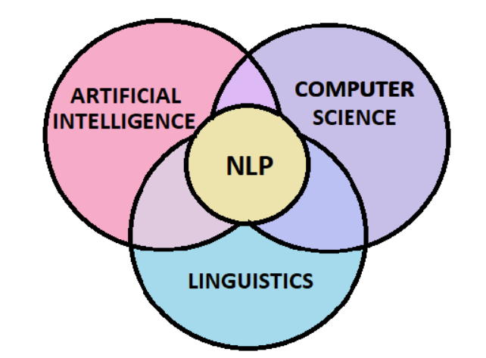
NLP

Slide 3
NLP
According to industry estimates, only 21% of the available data is present in a structured form. Data is being generated as we speak, as we tweet, as we send messages on WhatsApp and in various other activities. The majority of this data exists in the textual form, which is highly unstructured in nature.
Despite having high-dimensional data, the information contained within it is not directly accessible unless it is processed manually or analyzed by an automated system. To derive meaningful and actionable insights from text data, it is crucial to understand the fundamentals of Natural Language Processing Basics.

Slide 4
What is Natural Language Processing?
NLP, or Natural Language Processing, is a type of computer technology that helps computers understand and work with human language.
It’s like teaching computers to understand what people say or write.
With NLP, computers can do things like translate languages, figure out if a piece of writing sounds positive or negative, summarize text, and more. This technology is used in things like virtual assistants, online chatbots, language translation apps, and search engines to help them understand and respond to human language better.

Slide 5
What are Corpus, Tokens, and Engrams?
A Corpus is defined as a collection of text documents for example a data set containing news is a corpus or the tweets containing Twitter data is a corpus. Another common example is Wikipedia itself.
So corpus consists of documents, documents comprise paragraphs, paragraphs comprise sentences and sentences comprise further smaller units which are called Tokens.

Slide 6
Tokens
Tokens can be words, phrases, or Engrams, and Engrams are defined as the group of n words together.
For example, consider this given sentence- “I love my phone.”
In this sentence, the uni-grams(n=1) are: I, love, my, phone
Di-grams(n=2) are: I love, love my, my phone
And tri-grams(n=3) are: I love my, love my phone
So, uni-grams are representing one word, di-grams are representing two words together and tri-grams are representing three words together.

Slide 7
Phrases
Types of Phrases
Noun Phrase (NP):
A noun phrase consists of a noun (or pronoun) and its modifiers. It can function as the subject, object, or complement in a sentence.
Example: "The tall building" (Here, "the tall building" is a noun phrase where "building" is the noun, and "the" and "tall" are its modifiers.)
Verb Phrase (VP):
A verb phrase includes a main verb and any auxiliary (helping) verbs, along with any objects or modifiers.
Example: "Has been running" (In this case, "has been running" is a verb phrase where "running" is the main verb and "has been" are auxiliary verbs.)
Adjective Phrase (AdjP):
An adjective phrase includes an adjective and its modifiers, providing additional description to a noun.
Example: "Very pleased with the results" (Here, "very pleased with the results" is an adjective phrase describing the noun it modifies.)

Slide 8
Phrases
Types of Phrases
Adverb Phrase (AdvP):
An adverb phrase includes an adverb and its modifiers, giving more detail about how, when, where, or to what extent something happens.
Example: "Quite early in the morning" (In this phrase, "quite early in the morning" describes how something occurs.)
Prepositional Phrase (PP):
A prepositional phrase starts with a preposition and is followed by a noun phrase or pronoun that serves as the object of the preposition.
Example: "Under the table" (Here, "under" is the preposition, and "the table" is the noun phrase that serves as its object.)
This info is important for PARTS OF SPEECH (POS) TAGGING AS WELL.

Slide 9
What is Tokenization?
Tokenization is a process of splitting a text object into smaller units which are also called tokens.
Examples of tokens can be words, numbers, engrams, or even symbols.
The most commonly used tokenization process is White-space Tokenization.
Check the tokenizer of
Openai: https://platform.openai.com/tokenizer

Slide 10
What is White-space Tokenization?
Also known as unigram tokenization. In this process, the entire text is split into words by splitting them from white spaces.
For example, in a sentence- “I went to New-York to play football.”
This will be splitted into following tokens: “I”, “went”, “to”, “New-York”, “to”, “play”, “football.”
Notice that “New-York” is not split further because the tokenization process was based on whitespaces only.

Slide 11
Tokenization
# Using split() function
text = "This is a sample sentence for tokenization."
words = text.split() # Splits on whitespace by default
print(words) # Output: ['This', 'is', 'a', 'sample', 'sentence', 'for', 'tokenization.']

Slide 12
What is Normalization?
Normalization is the process of converting a token into its base form. In the normalization process, the inflection from a word is removed so that the base form can be obtained. So, the normalized form of anti-nationalist is national.
There are two common types i.e. stemming and lemmatization.

Slide 13
Stemming
Stemming is an elementary rule-based process for removing inflectional forms from a token and the outputs are the stem of the world.
For example, “laughing”, “laughed“, “laughs”, “laugh” will all become “laugh”, which is their stem, because their inflection form will be removed.
Stemming is not a good normalization process because sometimes stemming can produce words that are not in the dictionary.
For example, consider a sentence: “His teams are not winning”
After stemming the tokens that we will get are- “hi”, “team”, “are”, “not”, “winn”
Notice that the keyword “winn” is not a regular word and “hi” changed the context of the entire sentence.

Slide 14
Stemming
from nltk.stem import PorterStemmer
# Define the text and stemmer
text = "This is a sample sentence for stemming . We will try stemming some verbs like running and playing ."
stemmer = PorterStemmer()
# Stem each word in the text
stemmed_words = []
for word in text.lower().split():
stemmed_word = stemmer.stem(word)
stemmed_words.append(stemmed_word)
# Join stemmed words back into a sentence
stemmed_text = ' '.join(stemmed_words)
print("Original Text:", text)
print("Stemmed Text:", stemmed_text)

Slide 15
What is Lemmatization?
Lemmatization, on the other hand, is a systematic step-by-step process for removing inflection forms of a word. It makes use of vocabulary, word structure, part of speech tags, and grammar relations.
The output of lemmatization is the root word called a lemma. For example,
Am, Are, Is >> Be
Running, Ran, Run >> Run
Comparatively slow.

Slide 16
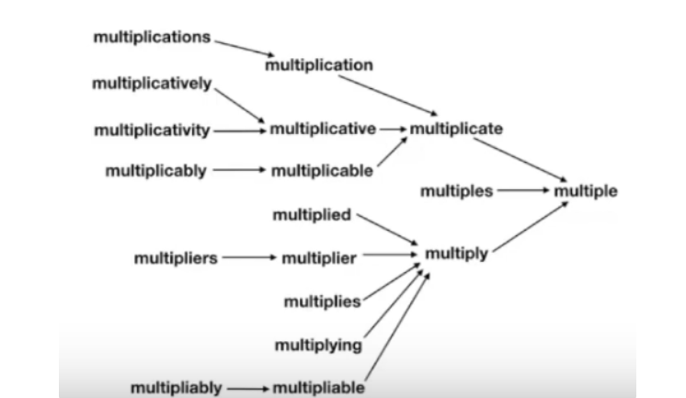
What is Lemmatization?

Slide 17
Lemmitization
from nltk.stem import WordNetLemmatizer
import nltk
nltk.download('wordnet') # large lexical database of English. Nouns, verbs, adjectives and adverbs
# Define the lemmatizer
lemmatizer = WordNetLemmatizer()
# Lemmatize each word in the text
print(lemmatizer.lemmatize("running", pos="v")) # in case of verb it is lemmatized while in case of noun it is not as per the rule
print(lemmatizer.lemmatize("playing", pos="n"))

Slide 18
Part of Speech(PoS) Tags
Part of speech tags or PoS tags is the properties of words that define their main context, their function, and the usage in a sentence. Some of the commonly used parts of speech tags are- Nouns, which define any object or entity; Verbs, which define some action; and Adjectives or Adverbs, which act as the modifiers, quantifiers, or intensifiers in any sentence.
In a sentence, every word will be associated with a proper part of the speech tag.

Slide 19
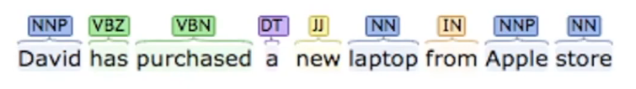
Part of Speech(PoS) Tags
In this case
“David’ has NNP tag which means it is a proper noun,
“has” and “purchased” belongs to verb indicating that they are the actions
“laptop” and “Apple store” are the nouns,
“new” is the adjective whose role is to modify the context of laptop.

Slide 20
Part of Speech(PoS) Tags
Part of speech tags is defined by the relations of words with the other words in the sentence.
Machine learning models or rule-based models are applied to obtain the part of speech tags of a word.
The most commonly used part of speech tagging notations is provided by the Penn Part of Speech Tagging.

Slide 21
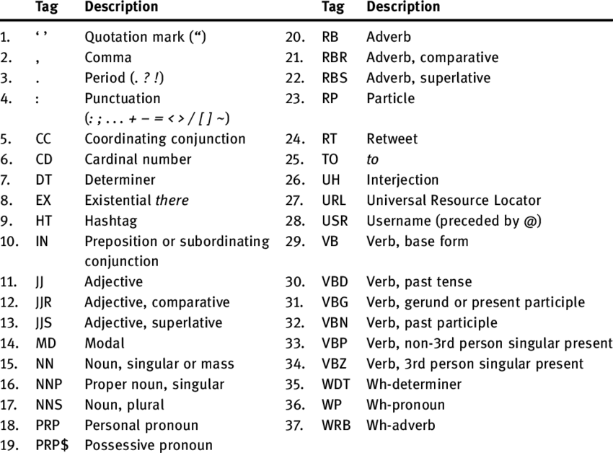

Slide 22
Part of Speech(PoS) Tags Applications
Part of speech tags have a large number of applications and they are used in a variety of tasks such as text cleaning, feature engineering tasks, and word sense disambiguation.
For example, consider these two sentences-
Sentence 1: “Please book my flight for NewYork”
Sentence 2: “I like to read a book on NewYork”
In both sentences, the keyword “book” is used but in sentence one, it is used as a verb while in sentence two it is used as a noun.

Slide 23
PoS Tagging - nltk
import nltk
nltk.download('averaged_perceptron_tagger')
from nltk import word_tokenize, pos_tag
# Download NLTK punkt sentence tokenizer (if not already downloaded)
nltk.download('punkt')
# Define the text
text = "This is a sample sentence for POS tagging."
# Tokenize the sentence (split into words)
tokens = word_tokenize(text)
# Perform POS tagging
tagged_words = pos_tag(tokens)
# Print the results
print("Original Text:", text)
print("POS Tags:", tagged_words)

Slide 24
Named Entity Recognition (NER)
At its core, Named Entity Recognition, or NER for short, is a subtask of NLP that focuses on identifying and classifying entities within textual data.
These entities encompass a diverse range of information, including names of individuals, organizations, locations, dates, numerical values, and more.
named entity recognition in python (NER) equips machines with the ability to extract these entities, making it a fundamental tool for diverse applications across various industries.

Slide 25
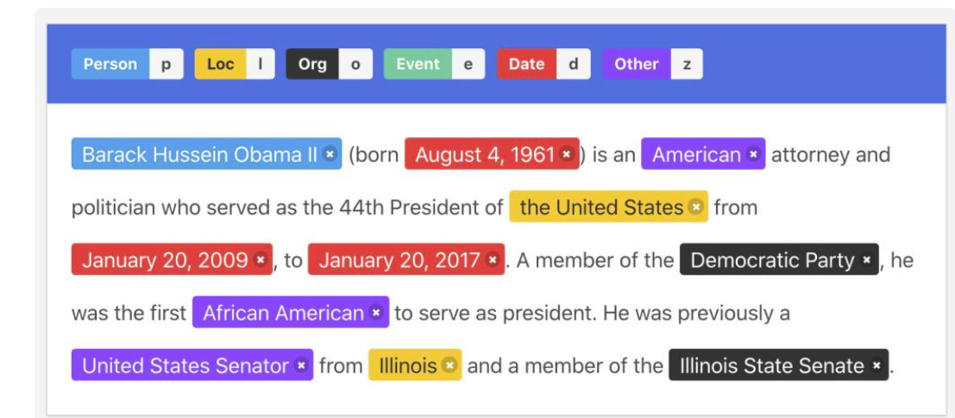
Named Entity Recognition (NER)

Slide 26
NER Applications
Customer Support
HR – Resume
Data annotation for LLM training
Notes:
https://farhan1572-farhanresumeparser.hf.space/?

Slide 27
NER
There are four different NER systems: rule-based, dictionary-based, machine learning (ML) based, and deep learning approaches. Let’s look at them one by one.

Slide 28
Tools for NER
Standford NER Tagger
Three-class model: recognizes the organizations, persons, and locations.
Four-class model: recognizes persons, organizations, locations, and miscellaneous entities.
Seven-class model: recognizes persons, organizations, locations, money, time, percentages, and dates.
Nltk 2.0 has the standford NER
Standford also provide POS tag models too.

Slide 29
Tools for NER
Spacy Pipelines for NER
Spacy mainly has three English pipelines optimized for CPU for Named Entity Recognition. They are:
en_core_web_sm
en_core_web_md
en_core_web_lg
en_core_web_trf (new) - transformer
https://spacy.io/models/en
The above pipelines are valid for POS tag too.

Slide 30
Spacy – POS - SMALL
import spacy
text = "Apple is looking at buying U.K. startup for $1 billion"
nlp = spacy.load("en_core_web_sm")
doc = nlp(text)
print(doc.text)
for token in doc:
print(token.text, token.pos_)

Slide 31
Spacy – NER - SMALL
import spacy
text = "Apple is looking at buying U.K. startup for $1 billion"
nlp = spacy.load("en_core_web_sm")
doc = nlp(text)
for ent in doc.ents:
print(ent.text, ent.label_)

Slide 32
SPACY – POS -TF
!python -m spacy download en_core_web_trf # restart session - so execute in a separate cell
import spacy
text = "Apple is looking at buying U.K. startup for $1 billion"
nlp = spacy.load("en_core_web_trf")
doc = nlp(text)
for token in doc:
print(token.text, token.pos_, token.dep_)

Slide 33
SPACY – NER -TF
for ent in doc.ents:
print(ent.text, ent.label_)

Slide 34
Text Preprocessing
1. Text Cleaning
This includes eliminating unwanted characters or symbols such as special characters (e.g., #, @, &), HTML tags, or extra whitespace. Cleaning the text helps in reducing variability and noise in the data.
2. Lowercasing: Converting all text to lowercase ensures consistency by avoiding the distinction between "Apple" and "apple." This step is crucial because it treats words with different cases as the same word.
3. Tokenization
Word Tokenization: Splitting text into individual words or tokens. This is one of the first steps in text preprocessing. For example, the sentence "I love NLP" is tokenized into ["I", "love", "NLP"].
Sentence Tokenization: Dividing text into sentences. This is important for tasks where sentence boundaries are relevant, such as sentiment analysis or summarization.
Notes:
https://pypi.org/project/text-processor-nlp/0.1/#files

Slide 35
Text Preprocessing
4. Removing Stop Words
Stop Words: Common words that are filtered out because they add little value in terms of analysis. Examples include "the," "is," "and," and "in." Removing these helps in focusing on more meaningful words in the text.

Slide 36
Text Preprocessing
4. Removing Stop Words
import nltk
from nltk.corpus import stopwords
# Download stopwords (if not already downloaded)
nltk.download('stopwords')
# Define the text
text = "This is a sample sentence for stopword removal. It has some common words like 'the', 'a', and 'is'."
# Get stopwords for English
stop_words = set(stopwords.words('english'))
# Remove stopwords from the text
filtered_text = [word for word in text.lower().split() if word not in stop_words]
print("Original Text:", text)
print("Filtered Text:", ' '.join(filtered_text))

Slide 37
Text Preprocessing
5. Normalization
Stemming: A process to reduce words to their root or base form by removing suffixes. For example, "running" becomes "run." Stemming is useful for reducing the dimensionality of text data but can sometimes lead to non-dictionary words.
Lemmatization: Similar to stemming, but it involves reducing words to their dictionary form or lemma. For example, "running" becomes "run," and "better" becomes "good." Lemmatization is more accurate than stemming but requires more computational resources.

Slide 38
Text Preprocessing
6. Handling Punctuation
Punctuation Removal: Removing punctuation marks (e.g., periods, commas, exclamation points) can help in standardizing the text and simplifying the analysis. However, in some cases, punctuation might be important for sentiment analysis or other specific tasks.
7. Removing Numbers
Numbers: Depending on the context, it may be necessary to remove or handle numbers separately. For example, in sentiment analysis, numbers may not provide useful information and can be removed.

Slide 39
Text Preprocessing
8. Handling Synonyms
Synonyms: Standardizing words that have the same or similar meanings. This can be done using thesauri or word embeddings to ensure that synonyms are treated as the same term.
9. Text Vectorization
Vectorization: Converting text into numerical representations, such as using Bag-of-Words (BoW), Term Frequency-Inverse Document Frequency (TF-IDF), or word embeddings. This step transforms text into a format suitable for machine learning algorithms.

Slide 40
Bag of Words (BoW)
Bag of Words (BOW) is an algorithm that counts how many times a word appears in a document.
Those word counts allow us to compare documents and gauge their similarities for applications like search, document classification, and topic modeling.

Slide 41
Bag of Words (BoW)
BoW represents text as a numerical vector where each dimension corresponds to the frequency of a word in the document.
Suppose we have three short documents:
Document 1: "The cat sat on the mat."
Document 2: "The dog jumped over the fence."
Document 3: "The cat and the dog are friends."
We'll follow these steps to create a Bag-of-Words representation:

Slide 42
Bag of Words (BoW)
1. Tokenization: Split each document into individual words, ignoring punctuation and case:
Document 1: ["the", "cat", "sat", "on", "the", "mat"]
Document 2: ["the", "dog", "jumped", "over", "the", "fence"]
Document 3: ["the", "cat", "and", "the", "dog", "are", "friends"]
2. Vocabulary Creation: Create a vocabulary from all unique words in the corpus:
Vocabulary: ["the", "cat", "sat", "on", "mat", "dog", "jumped", "over", "fence", "and", "are", "friends"]

Slide 43
Bag of Words (BoW)
3. Vectorization: Represent each document as a numerical vector where each dimension corresponds to a word in the vocabulary, and the value of each dimension represents the frequency of that word in the document:
Document 1: [2, 1, 1, 1, 1, 0, 0, 0, 0, 0, 0, 0]
Document 2: [2, 0, 0, 0, 0, 1, 1, 1, 1, 0, 0, 0]
Document 3: [2, 1, 0, 0, 0, 1, 0, 0, 0, 1, 1, 1]
Sparse Representation: Since most documents contain only a subset of the words in the vocabulary, the vectors are typically sparse. For example, Document 1 only contains words from indices 0 to 4.

Slide 44
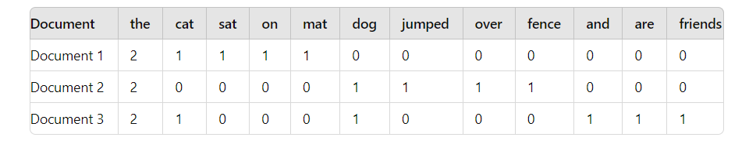
Bag of Words (BoW)
3. Vectorization: Represent each document as a numerical vector where each dimension corresponds to a word in the vocabulary, and the value of each dimension represents the frequency of that word in the document:
Document 1: [2, 1, 1, 1, 1, 0, 0, 0, 0, 0, 0, 0]
Document 2: [2, 0, 0, 0, 0, 1, 1, 1, 1, 0, 0, 0]
Document 3: [2, 1, 0, 0, 0, 1, 0, 0, 0, 1, 1, 1]

Slide 45
Bag of Words (BoW)
from collections import Counter
def create_bow(text):
"""
This function creates a bag-of-words representation of a text document.
Args:
text: A string containing the text document.
Returns:
A dictionary where keys are unique words and values are their frequencies in the text.
"""
# Preprocess text (optional): lowercase, remove punctuation, etc.
# Here, we'll just convert to lowercase for simplicity.
text = text.lower()
# Tokenize the text (split into words)
tokens = text.split()
# Create a word count dictionary using Counter
word_counts = Counter(tokens)
return word_counts
# use
text = "This is a sample sentence for creating a bag of words. It contains repeated words."
bow = create_bow(text)
print("Original Text:", text)
print("Bag of Words:", bow)

Slide 46
Term Frequency-Inverse Document Frequency (TF-IDF)
TF-IDF improves upon the Bag of Words model by not just counting word frequencies, but also adjusting for how common or rare a word is across multiple documents. It helps to identify important words that are not too common across all documents. Here’s a basic breakdown:
Term Frequency (TF): Measures how often a word appears in a document. For example, in the sentence "I love NLP," the word "NLP" appears once, so its TF is 1.
Inverse Document Frequency (IDF): Measures how common or rare a word is across a set of documents. Words that appear in many documents are less informative. For instance, if "NLP" appears in 10 out of 20 documents, its IDF is lower because it is common. Words that appear in only a few documents have higher IDF values.
TF-IDF Score: Combines TF and IDF to give a score that represents the importance of a word in a document relative to its frequency across all documents. For "NLP" in our example, its TF-IDF score will be higher if it’s rare across documents but frequently appears in the specific document.

Slide 47
Term Frequency-Inverse Document Frequency (TF-IDF)
TF-IDF measures the importance of a word in a document relative to a collection of documents, considering both its frequency in the document and its rarity in the corpus.
Document 1: "The cat sat on the mat."
Document 2: "The dog jumped over the fence."
Document 3: "The cat and the dog are friends."
We'll follow these steps to create a TF-IDF representation:

Slide 48
Term Frequency-Inverse Document Frequency (TF-IDF)
1. Tokenization: Split each document into individual words, ignoring punctuation and case:
Document 1: ["the", "cat", "sat", "on", "the", "mat"]
Document 2: ["the", "dog", "jumped", "over", "the", "fence"]
Document 3: ["the", "cat", "and", "the", "dog", "are", "friends"]
2. Term Frequency (TF): Calculate the frequency of each word in each document:
Term Frequency (TF) for Document 1: {"the": 2, "cat": 1, "sat": 1, "on": 1, "mat": 1}
Term Frequency (TF) for Document 2: {"the": 2, "dog": 1, "jumped": 1, "over": 1, "fence": 1}
Term Frequency (TF) for Document 3: {"the": 2, "cat": 1, "and": 1, "dog": 1, "are": 1, "friends": 1}

Slide 49
Term Frequency-Inverse Document Frequency (TF-IDF)
3. Inverse Document Frequency (IDF): Calculate the inverse document frequency of each word:
IDF for "the" = log(total number of documents / number of documents containing "the") = log(3 / 3) = 0
IDF for "cat" = log(3 / 2) ≈ 0.176
IDF for "sat" = log(3 / 1) ≈ 1.099
IDF for "on" = log(3 / 1) ≈ 1.099
IDF for "mat" = log(3 / 1) ≈ 1.099
IDF for "dog" = log(3 / 2) ≈ 0.176
IDF for "jumped" = log(3 / 1) ≈ 1.099
IDF for "over" = log(3 / 1) ≈ 1.099
IDF for "fence" = log(3 / 1) ≈ 1.099
IDF for "and" = log(3 / 1) ≈ 1.099
IDF for "are" = log(3 / 1) ≈ 1.099
IDF for "friends" = log(3 / 1) ≈ 1.099

Slide 50
Term Frequency-Inverse Document Frequency (TF-IDF)
4. TF-IDF Calculation: Multiply the term frequency (TF) of each word in each document by its inverse document frequency (IDF):
TF-IDF for Document 1: {"the": 0, "cat": 0.176, "sat": 1.099, "on": 1.099, "mat": 1.099}
TF-IDF for Document 2: {"the": 0, "dog": 0.176, "jumped": 1.099, "over": 1.099, "fence": 1.099}
TF-IDF for Document 3: {"the": 0, "cat": 0.176, "and": 1.099, "dog": 0.176, "are": 1.099, "friends": 1.099}

Slide 51
Term Frequency-Inverse Document Frequency (TF-IDF)
from sklearn.feature_extraction.text import TfidfVectorizer
from sklearn.preprocessing import MinMaxScaler
# Define some sample text documents
documents = [
"This is the first document about natural language processing.",
"This document is about machine learning algorithms.",
"This is another document related to natural language processing."
]

Slide 52
Term Frequency-Inverse Document Frequency (TF-IDF)
# Create a TF-IDF vectorizer
vectorizer = TfidfVectorizer()
# Fit the vectorizer on the documents
vectorizer.fit(documents)
# Transform the documents into TF-IDF vectors
tfidf_vectors = vectorizer.transform(documents)
# Normalize TF-IDF scores (0 to 1)
scaler = MinMaxScaler(feature_range=(0, 1))
tfidf_vectors_normalized = scaler.fit_transform(tfidf_vectors.toarray())

Slide 53
Term Frequency-Inverse Document Frequency (TF-IDF)
# Print normalized TF-IDF vectors
print("Normalized TF-IDF Vectors:\n", tfidf_vectors_normalized)
# Get top 3 words per document (optional)
feature_names = vectorizer.get_feature_names_out()
for i, doc in enumerate(tfidf_vectors_normalized):
# Sort word-score pairs by score in descending order
sorted_by_score = sorted(zip(feature_names, doc), key=lambda x: x[1], reverse=True)
print(f"Top 3 Words (Document {i+1}):")
for word, score in sorted_by_score[:3]:
print(f"\t- {word}: {score:.4f}")

Slide 54
Embedding
GloVe
GloVe (Global Vectors for Word Representation), is designed to capture the semantic meaning of words in a continuous vector space, often referred to as word vectors or word embeddings.
GloVe starts by constructing a co-occurrence matrix from a large text corpus. Each entry in this matrix represents how often a word appears near another word.
The rows and columns of this matrix correspond to words in the vocabulary.

Slide 55
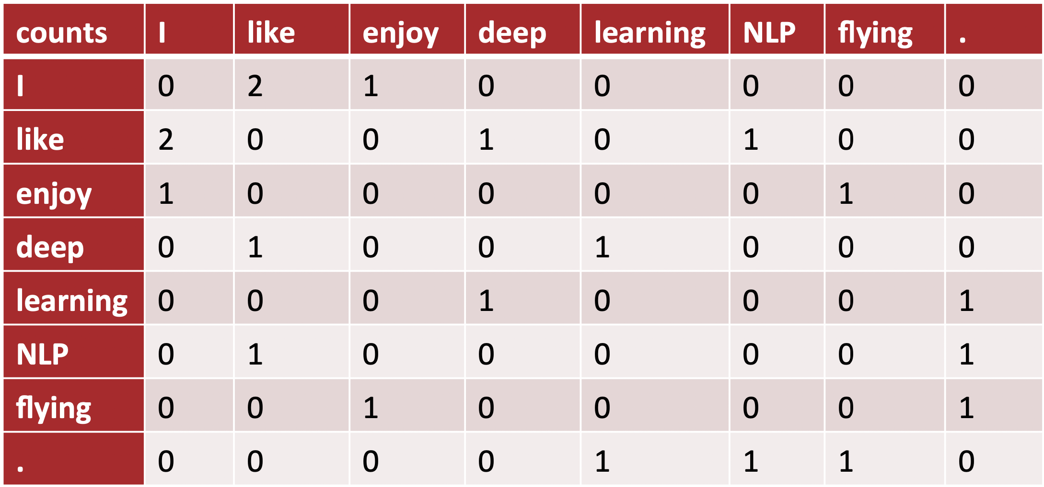
Embedding
GloVe – Co Occurrence Matrix

Slide 56
Embedding
Word2Vec:
Developed by Google, Word2Vec uses either the Continuous Bag of Words (CBOW) or Skip-gram models to learn word embeddings. CBOW predicts a word based on its context, while Skip-gram does the reverse, predicting the context from a given word.
FastText:
Developed by Facebook, FastText improves on Word2Vec by representing words as bags of character n-grams. This helps in handling morphological variations and out-of-vocabulary words more effectively.
Contextual Embeddings:
Models like BERT (Bidirectional Encoder Representations from Transformers) and GPT (Generative Pre-trained Transformer) generate embeddings that are context-dependent. This means the embedding for a word changes based on the surrounding words, capturing the word’s meaning in different contexts.

Slide 57
Text Classification
Text classification is a fundamental task in Natural Language Processing (NLP) where the goal is to categorize text into predefined labels or categories.
This process involves training a model to recognize patterns and features in the text that correspond to different classes.
For example, in email filtering, text classification can be used to sort emails into categories like "spam" or "not spam." Similarly, in news categorization, it can classify articles into topics like "sports," "politics," or "technology.“

Slide 58
Text Classification
The process generally starts with preparing a dataset that includes text samples along with their associated labels.
Text preprocessing techniques, such as tokenization and removing stop words, are applied to clean and format the data.
Features are then extracted from the text, often using methods like Bag of Words (BoW) or Term Frequency-Inverse Document Frequency (TF-IDF), which convert text into numerical vectors.
These vectors are used to train a machine learning model, such as a logistic regression classifier, a support vector machine, or a neural network.
The trained model can then predict the category of new, unseen text based on the patterns it learned during training.

Slide 59
Sentiment Analysis
Sentiment analysis, a specialized form of text classification, focuses on determining the emotional tone or sentiment expressed in a piece of text.
It is commonly used to analyze opinions and feedback, such as customer reviews, social media posts, or product ratings.
The goal is to classify the sentiment into categories like "positive," "negative," or "neutral," and sometimes into more nuanced emotions like "joy," "anger," or "sadness.“

Slide 60
Sentiment Analysis
The process begins similarly to text classification, with text preprocessing to clean and prepare the data.
Next, sentiment-specific features may be extracted, or pre-trained sentiment analysis models can be used.
Sentiment analysis models are often built using supervised learning approaches, where the model is trained on a labeled dataset containing text and its associated sentiment labels.

Slide 61
NLP Libraries and Frameworks
NLTK (Natural Language Toolkit):
Functionality: Comprehensive NLP tools for various tasks.
Use Cases: Text classification, tokenization, and linguistic analysis.
spaCy:
Functionality: Fast and efficient NLP library with pre-trained models.
Use Cases: Named entity recognition, part-of-speech tagging, and text tokenization

Slide 62
NLP Libraries and Frameworks
3. Gensim:
Functionality: Specializes in topic modeling and document similarity.
Use Cases: Topic modeling, document similarity, and word embeddings.
4. Hugging Face Transformers:
Functionality: Framework for state-of-the-art NLP models.
Use Cases: Text classification, machine translation, and text generation with pre-trained models like BERT and GPT-2.

Slide 63
NLP in Real World
Chatbots: NLP powers automated chat systems for customer support and information retrieval.
Sentiment Analysis: NLP analyzes social media data to gauge public sentiment about products and services.
Language Translation: NLP facilitates automatic translation between languages, like Google Translate.
Healthcare Records: NLP extracts insights from medical records for diagnosis, monitoring, and research.
Legal Document Summarization: NLP automates the summarization of lengthy legal documents.
Text Classification: NLP is used for tasks like spam detection and news categorization.
Language Understanding: NLP enables voice assistants to understand and respond to spoken commands.
Autocorrect and Autocomplete: NLP assists users in writing more accurately and efficiently.
Recommendation Systems: NLP personalizes product, movie, and content recommendations.
Content Generation: NLP models can generate human-like text for content creation.

